Slide 1
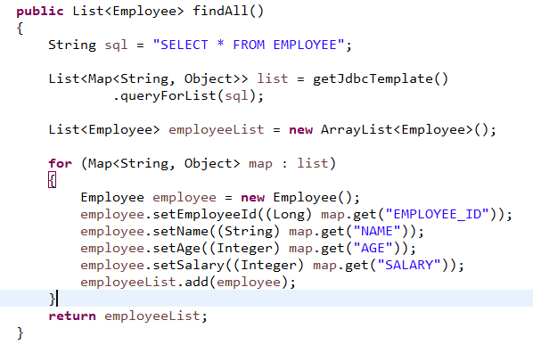
Querying for Multiple Rows
We can query or extract multiple rows from database, and convert it into a List.

